Slide 1




Predicting Infant Mortality:
A Global Analysis of 2023 Data
Ruchitha | Shravanthika | Ramya | Madirai | Deepika
Aurora Degree & P.G College | M. Sc (Applied Statistics)
Mentor: Rajya Lakshmi Ma’am

Slide 2
2
ABSTRACT
This study explores various machine learning models to predict infant mortality rates across different countries.
We evaluate multiple algorithms, including linear regression, random forests, support vector machines and more.

Slide 3
3
CONTENT
Introduction 4
Objectives 5
Literature Review 6
About data 8
Data Cleaning 10
EDA 12
Modelling 23
Result 29
Conclusion 30
Recommendation 32
Methodology

Slide 4
4
bACKGROUND
As per UNICEF and WHO in 2022, approximately 2.3 million children died in their first month of life, which translate to about 6,300 neonatal deaths daily. The average global neonatal mortality rate was 17 deaths per 1000 live births, a significant reduction from 37 deaths in 1990.
Despite progress in reducing infant mortality rates globally, challenges persists, particularly in vulnerable regions. Continued monitoring are essential for meeting the Sustainable Development Goal 3 i.e good health and well-being
Notes:
1.Infant mortality, a key health indicator, remains a major concern globally, particularly in low and middle income countries.
The infant mortality rate (IMR) is often regarded as a barometer for overall welfare of a community or country.
2.Predicting infant mortality through global models is essential for identifying at risk populations, these models help policymakers and organizations allocate resources effectively.
3. our project aims at Tackling the complex socio-economic and healthcare factors influencing infant mortality. Which at-large goals like UN’s Sustainable Development Goal 3 i.e good health and well-being can be achieved.

Slide 5

5
INTRODUCTION
The infant mortality rate (IMR) is often regarded as a barometer for the overall welfare of a community or country.
It refers to the number of deaths per 1000 live births within the year
Notes:
1.Infant mortality, a key health indicator, remains a major concern globally, particularly in low and middle income countries.
The infant mortality rate (IMR) is often regarded as a barometer for overall welfare of a community or country.
2.Predicting infant mortality through global models is essential for identifying at risk populations, these models help policymakers and organizations allocate resources effectively.
3. our project aims at Tackling the complex socio-economic and healthcare factors influencing infant mortality. Which at-large goals like UN’s Sustainable Development Goal 3 i.e good health and well-being can be achieved.

Slide 6
6
OBJECTIVES
Objective 1
Objective 2
To identify the significant factors that influence the infant mortality globally.
To develop the most accurate machine learning model for predicting infant mortality on a global scale

Slide 7
7
LITERATURE REVIEW
In a study by Zakir Hossain, Enamul Kabir, and Rumana Rois (November 2021), machine learning algorithms were used to identify predictors of infant mortality in Bangladesh using data from the 2017–18 Demographic and Health Survey. Key features like age at first marriage, birth interval, and education were found significant. Among various ML models, random forest performed best with an accuracy of 89.3% and an AUC of 0.6613. The findings can guide policy-makers and public health interventions aimed at reducing infant mortality
1
Leonardo Matsuno da Frota et al. (March 2024) used machine learning to predict infant mortality in Brazil from 2.9 million Brazil’s Unique Health System(SUS) data points. Survival Support Vector Machines and Extreme Gradient Boosting achieved high accuracy (c-index: 0.84 and 0.83). The Cox model also performed well (c-index: 0.83), highlighting machine learning's role in enhancing mortality predictions and informing health policy.
2
3

Slide 8
6
8
Dataset
Data Source:
The Dataset for this project is secondary data taken from Kaggle repository.
https://www.kaggle.com/datasets/nelgiriyewithana/countries-of-the-world-2023/data
Description:
The Dataset contains 195 countries as rows and 27 features.
some of the features include Country, Population, Land Area, Agriculture Land, Co2- Emissions , CPI, Fertility Rate, Forested Area, Gasoline Price, GDP, Life Expectancy, Maternal Mortality ratio, Minimum wage, Density, Longitude, Latitude.

Slide 9
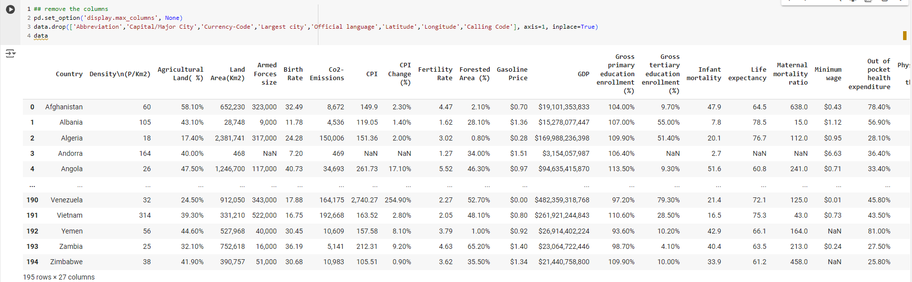
9
Data overview

Slide 10
10
Methodology
Preprocessing Data
Handling missing values
Deleting the unwanted variables
Statistical Methods
Multicollinear check using VIF
Testing of significance for Multiple Linear Regression.
Multiple Linear Regression using OLS method.
Machine learning Models
Machine learning models are fitting at various splits for testing for overfitting of the data.

Slide 11

11
Data
Cleaning

Slide 12
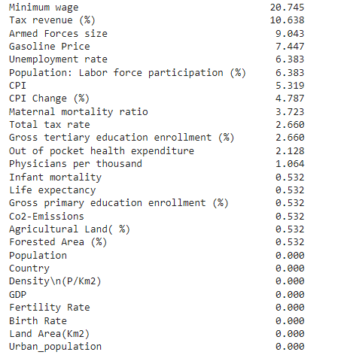
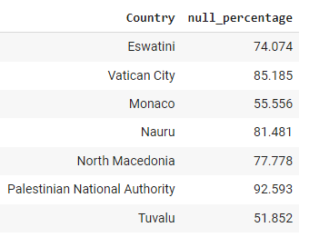
Handling missing data
12
Feature wise missing percentage
Dropped country with more than 90% missing values
* Please refer to Appendix page 31 for a data descriptions

Slide 13

13
EXPLORATORY DATA ANALYSIS

Slide 14
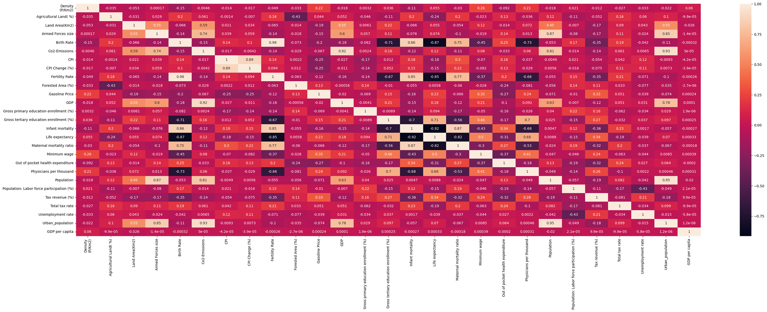
14
Correlation Matrix

Slide 15
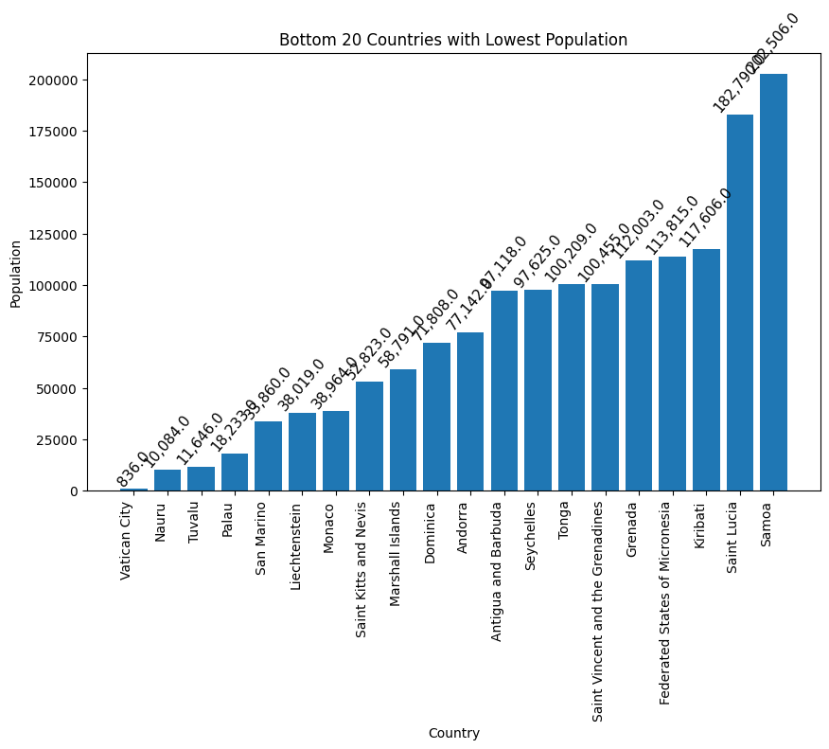
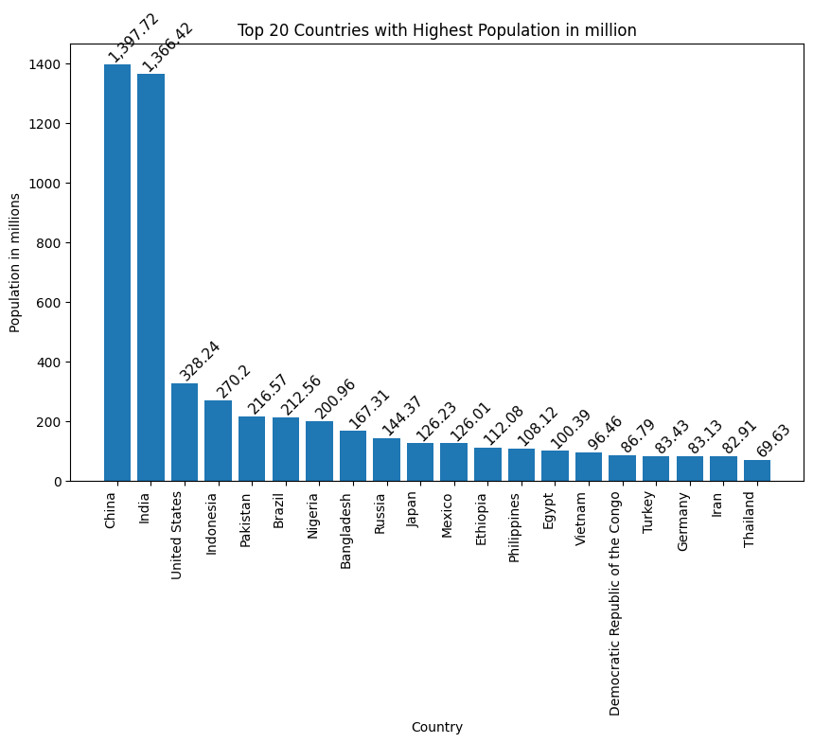
15
Bar plot
Countries vs Population
Bottom 20 Countries with lower Population
Top 20 Countries with High Population (in M)

Slide 16
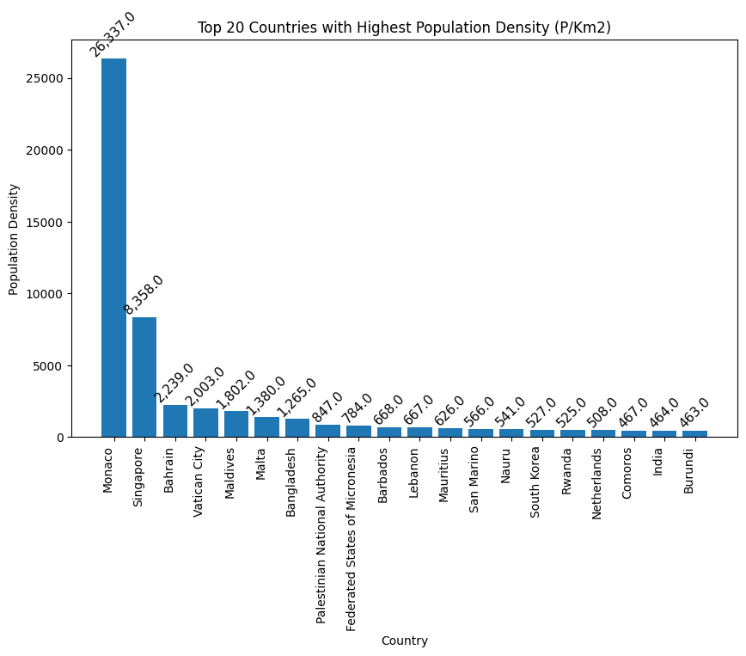
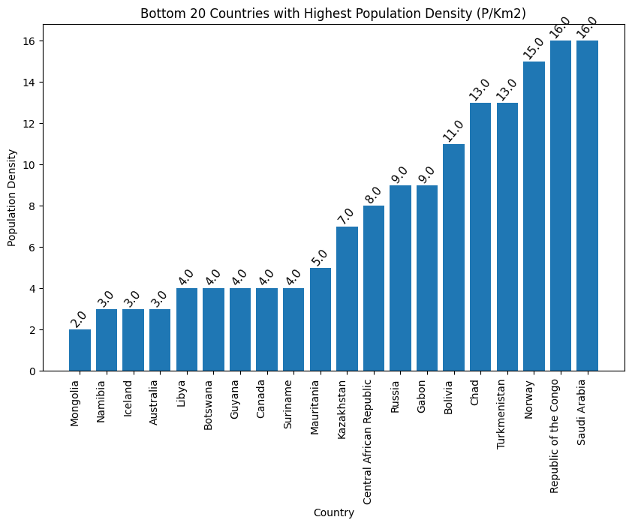
16
Countries with Population Density
Top 20 Countries with Highest Population Density
Bottom 20 Countries with Lowest population Density

Slide 17
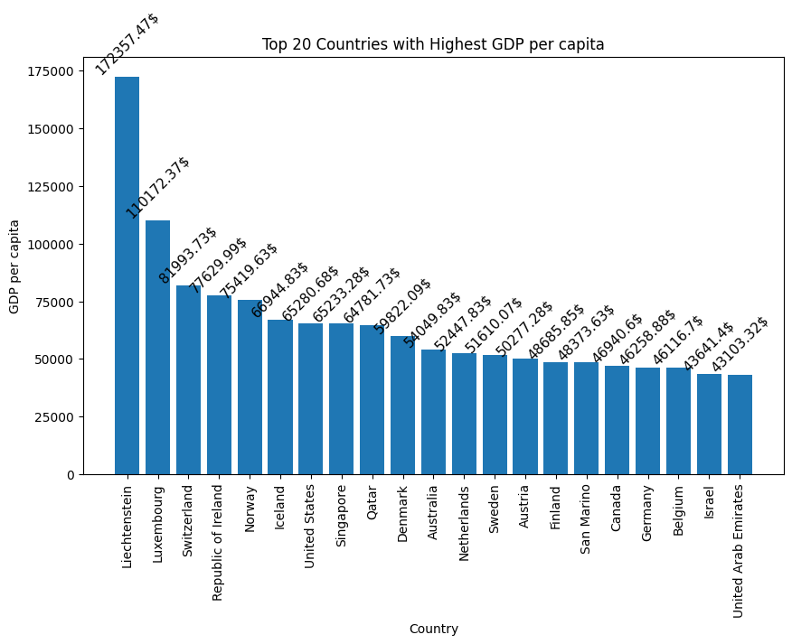
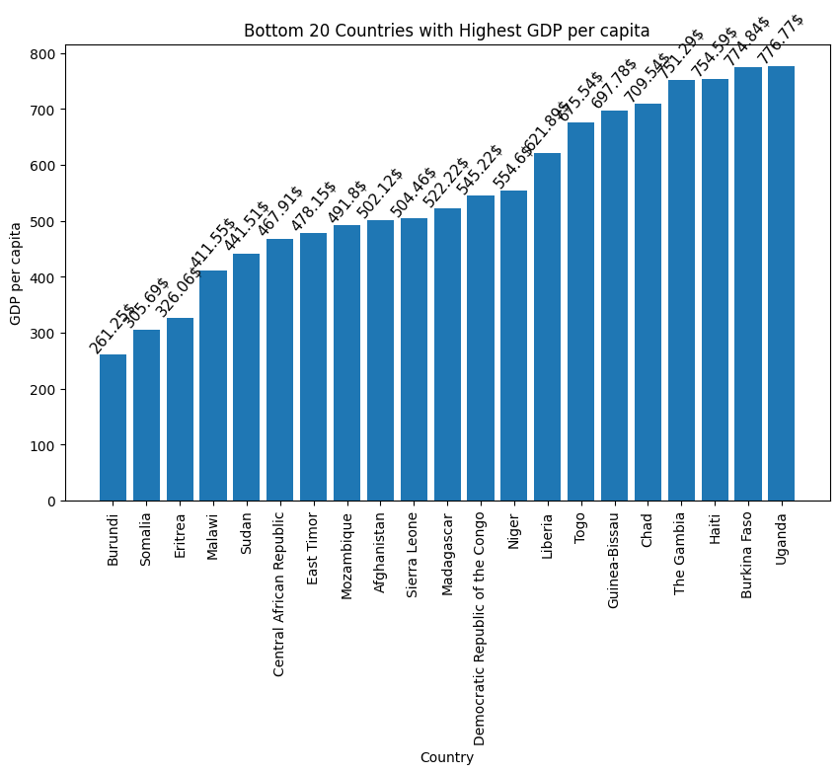
17
Countries with GDP Per Capita
Top 20 Countries with GDP per capita
Bottom 20 Countries with GDP per capita

Slide 18
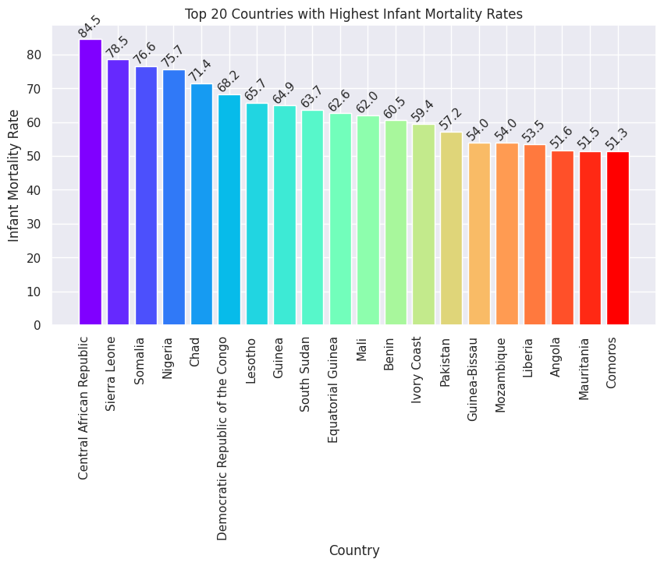
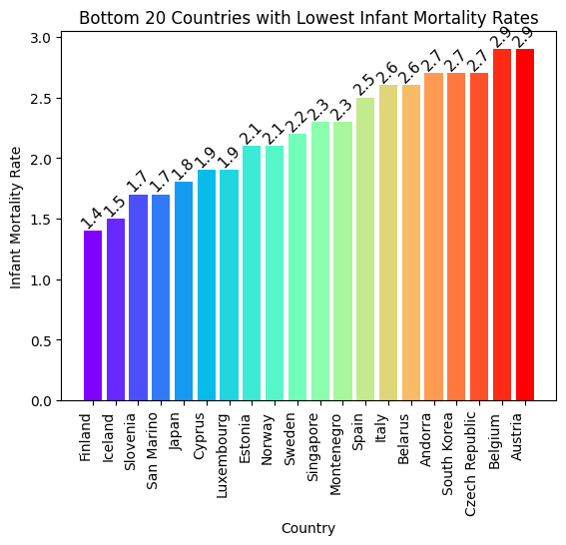
18
Country with Infant Mortality
Top 20 Countries with Highest IMR
Bottom 20 Countries with lowest IMR

Slide 19
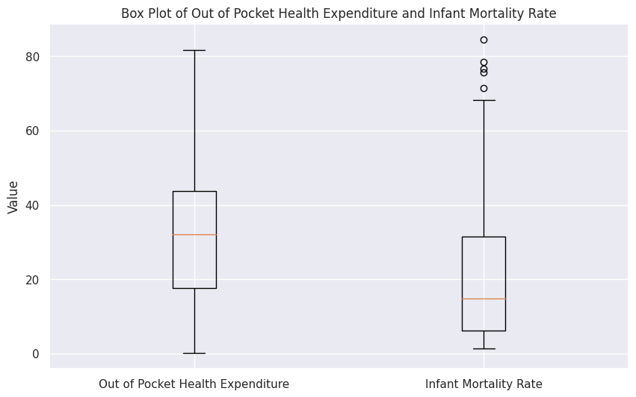
19
Box Plot
Health Expenditure and Infant Mortality Rate
84
81
32
14
This means that in half of the countries, people spend 32% of their healthcare costs out of their own pockets.
This indicates that in half of the countries, the infant mortality rate is 14 or lower.

Slide 20
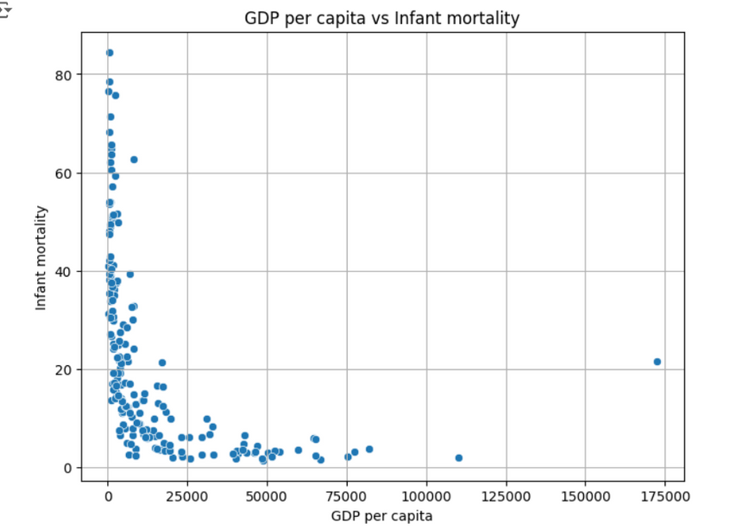
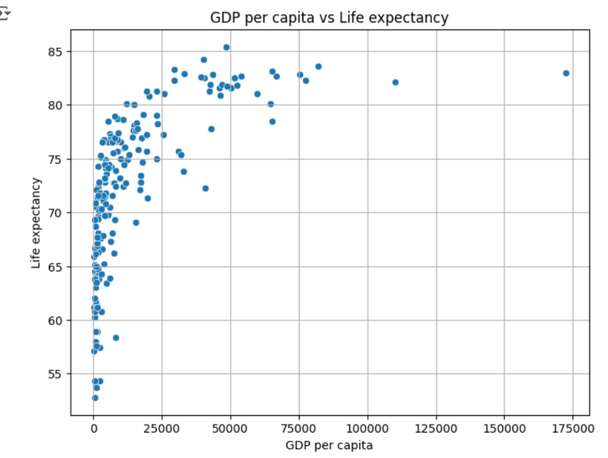
20
Scatter Plot
Infant Mortality vs GDP Per Capita
GDP per Capita vs Life Expectancy
Infant mortality
IMR vs GDP per Capita
Most of the countries have less than $50,000 GDP per capita
having Infant mortality is upto 80 years.
Most of the countries are concentrated with
Life expectancy <80 and GDP per capita $25,000.

Slide 21
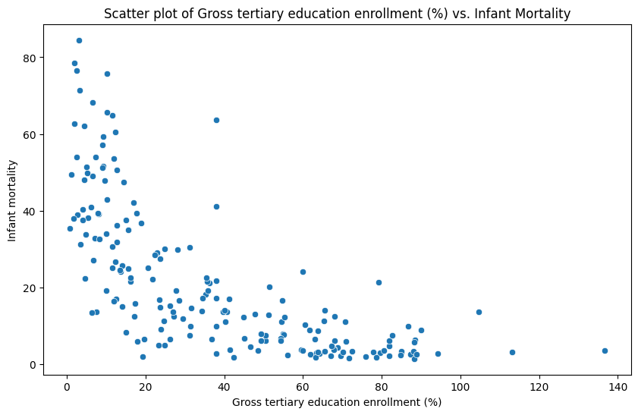
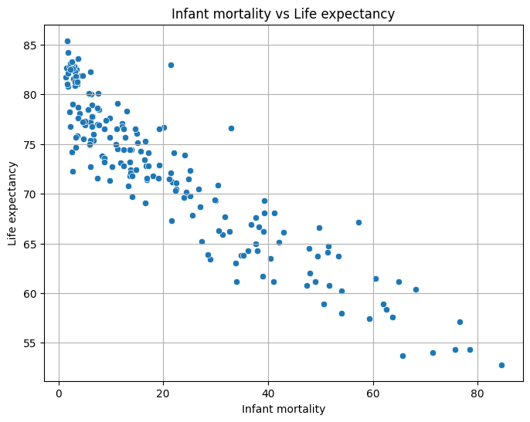
21
Gross Tertiary Education Enrolment vs IMR
Life Expectancy vs IMR
Scatter plot of Gross Tertiary Education enrolment vs IMR
The countries with higher education enrolment have lower infant mortality
And higher infant mortality have lower education enrolment.
The countries with higher life expectancy have lower infant mortality
And higher infant mortality have lower life expectancy.
* Please refer to Appendix page 36 for more plots

Slide 22
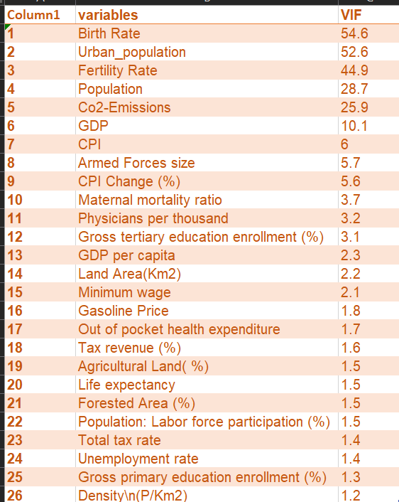
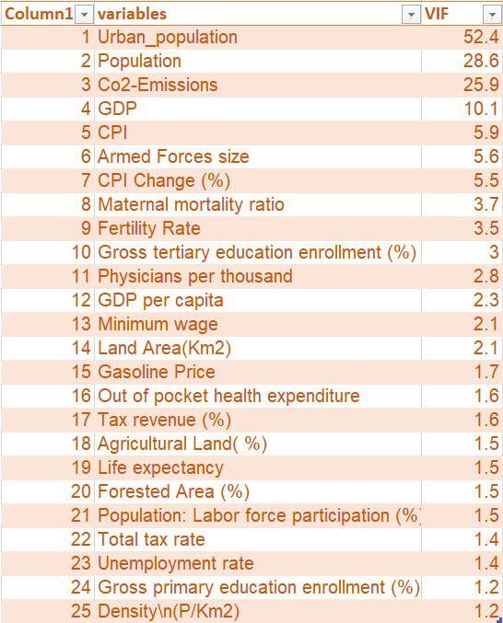
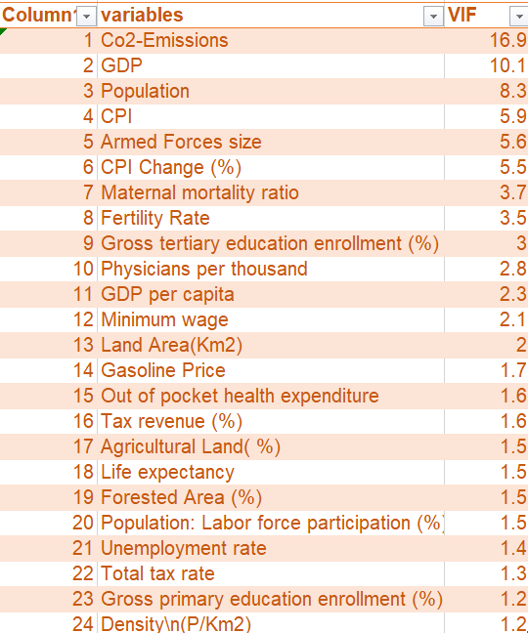
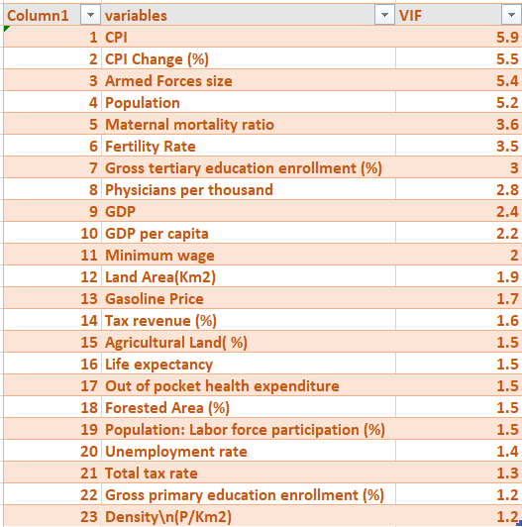
Multicollinearity check
22
Table 1
Table 2
Table 3
Table 4
The features like Birth Rate, Urban_ population, Co2-Emission were multicollinear in our dataset.

Slide 23
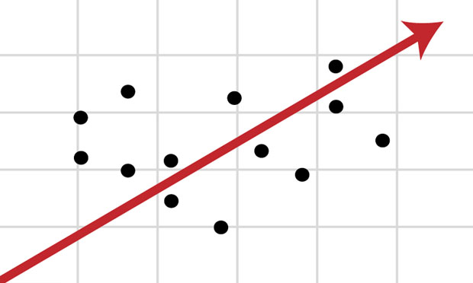
23
DATA
MODELLING

Slide 24
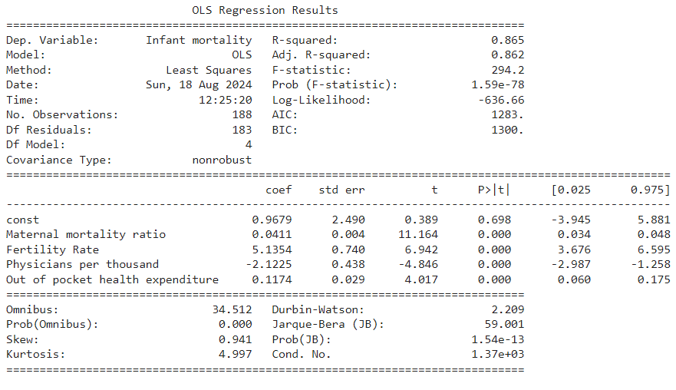
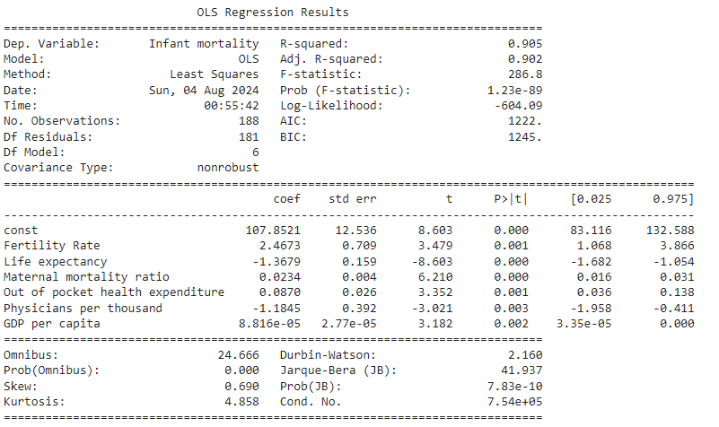
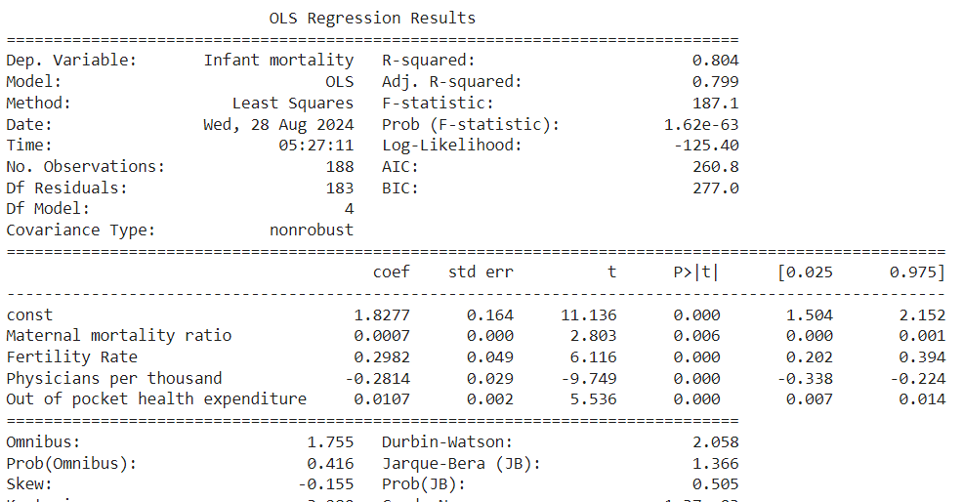
Significance Test for Multiple Linear Regression
24
Ordinary Least squares

Slide 25
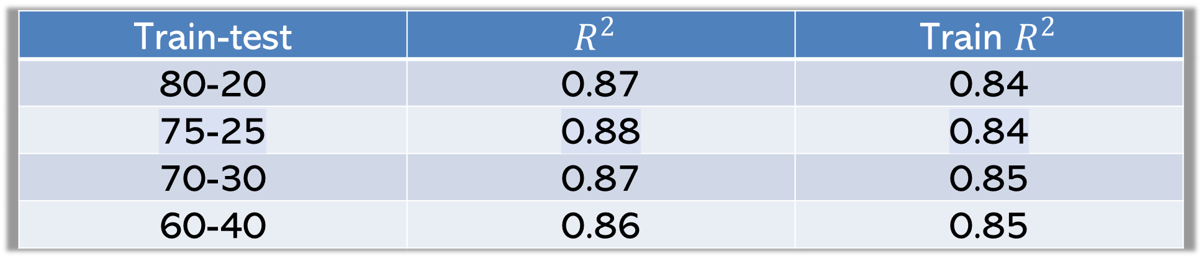
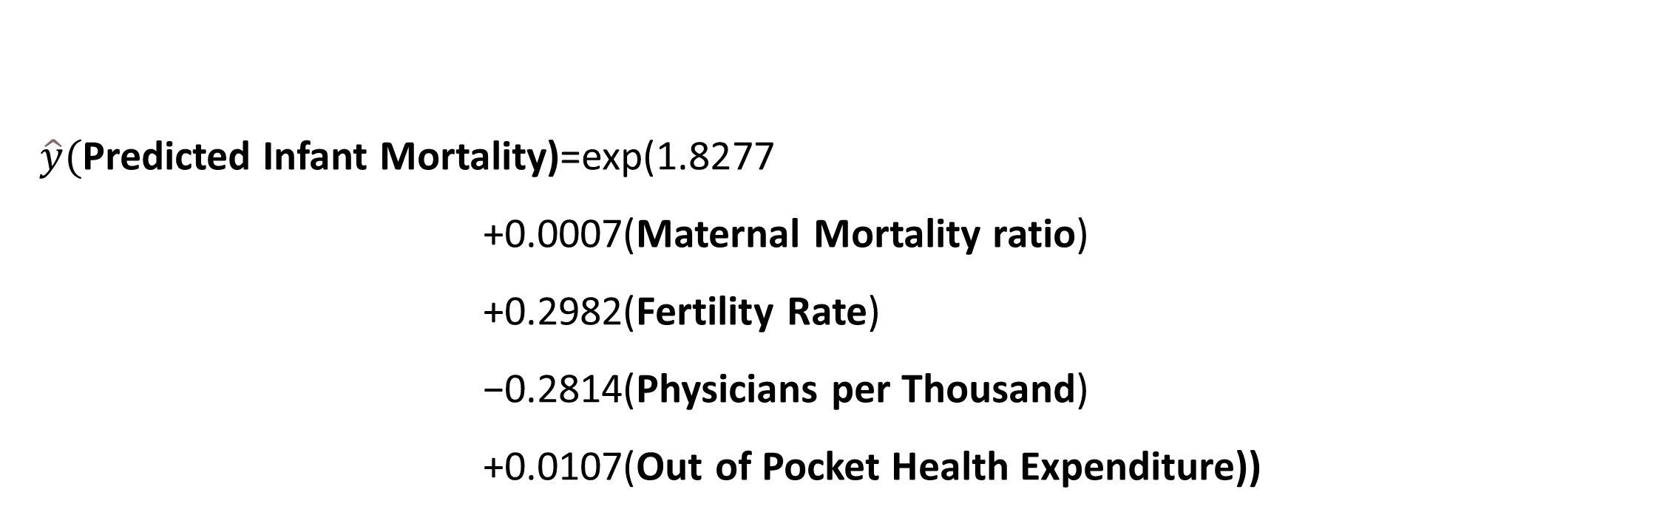

24
Multiple Linear Regression
$\hat{y}($Predicted Infant Mortality)=exp(1.8277
+0.0007(Maternal Mortality ratio)
+0.2982(Fertility Rate)
−0.2814(Physicians per Thousand)
+0.0107(Out of Pocket Health Expenditure))
Train-test | $$R^{2}$$ | Train $R^{2}$
80-20 | 0.87 | 0.84
75-25 | 0.88 | 0.84
70-30 | 0.87 | 0.85
60-40 | 0.86 | 0.85
Here the Multiple Regression is the good fit with 88% $R^{2}$

Slide 26
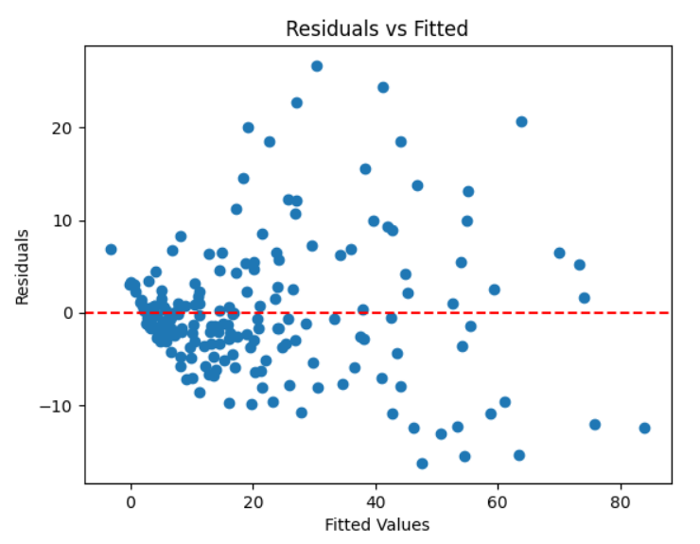
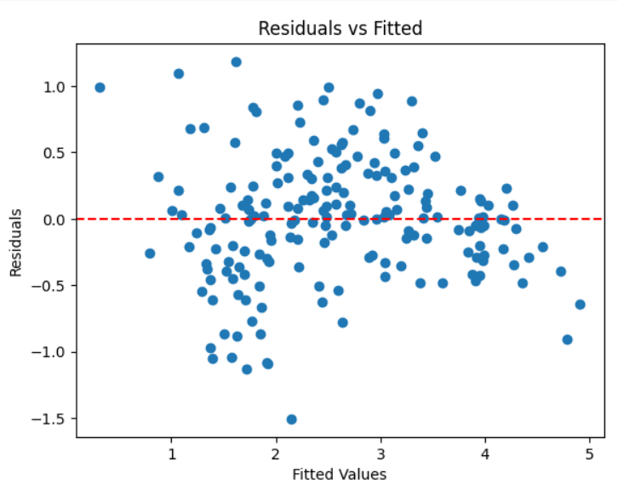
26
CHECK FOR ASSUMPTIONS OF OLS
Before transformation of IMR
After transformation of IMR

Slide 27
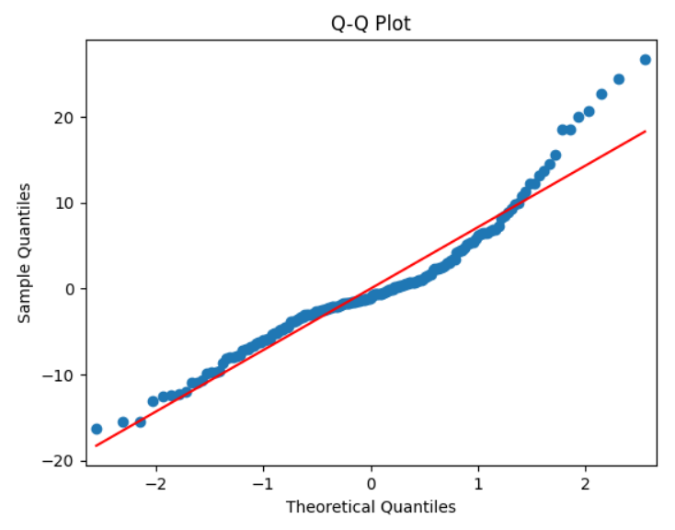
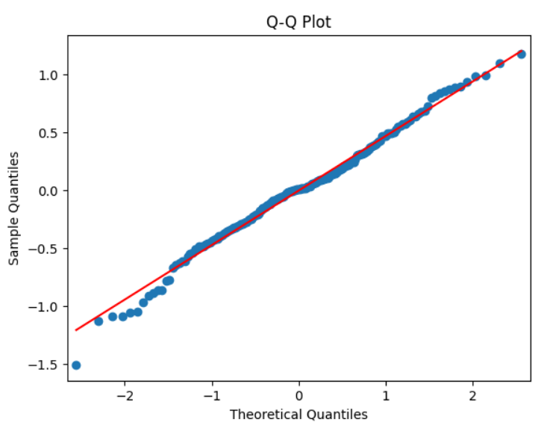
27
Q-Q plot
Before transformation of IMR
After transformation of IMR

Slide 28
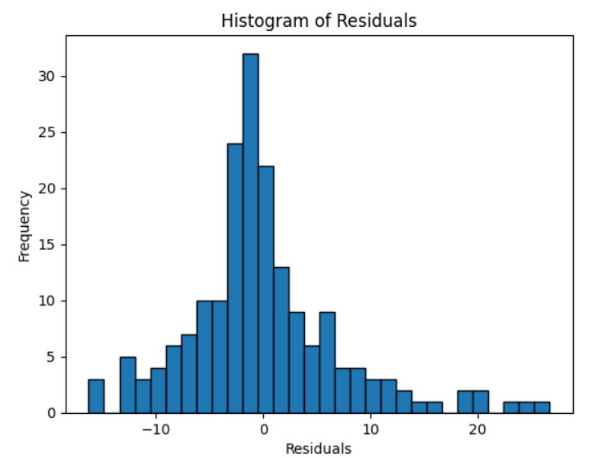
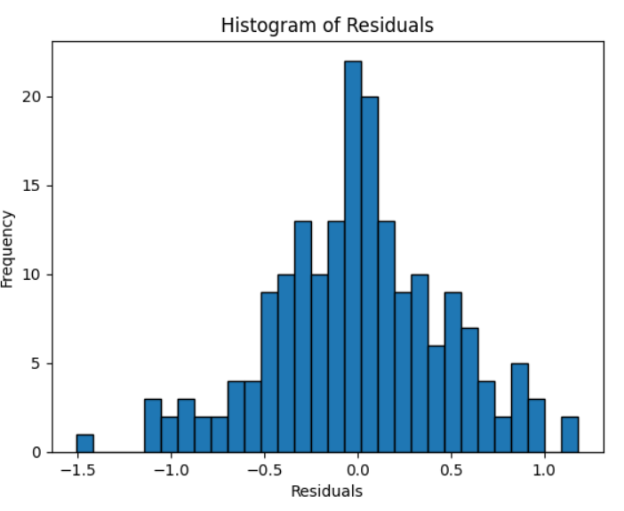
28
Histogram of Residuals
Before transformation of IMR
After transformation of IMR

Slide 29
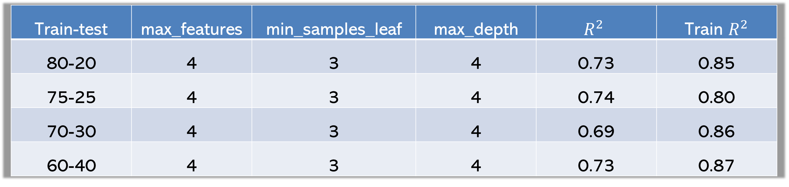

29
Decision Tree
Train-test | max_features | min_samples_leaf | max_depth | $$R^{2}$$ | Train $R^{2}$
80-20 | 4 | 3 | 4 | 0.73 | 0.85
75-25 | 4 | 3 | 4 | 0.74 | 0.80
70-30 | 4 | 3 | 4 | 0.69 | 0.86
60-40 | 4 | 3 | 4 | 0.73 | 0.87
Here the Decision Tree is consistent for different train-test ratio’s as $R^{2}$ is about 70%
* Please refer to Appendix page 43 for a detailed Decision Tree diagram

Slide 30

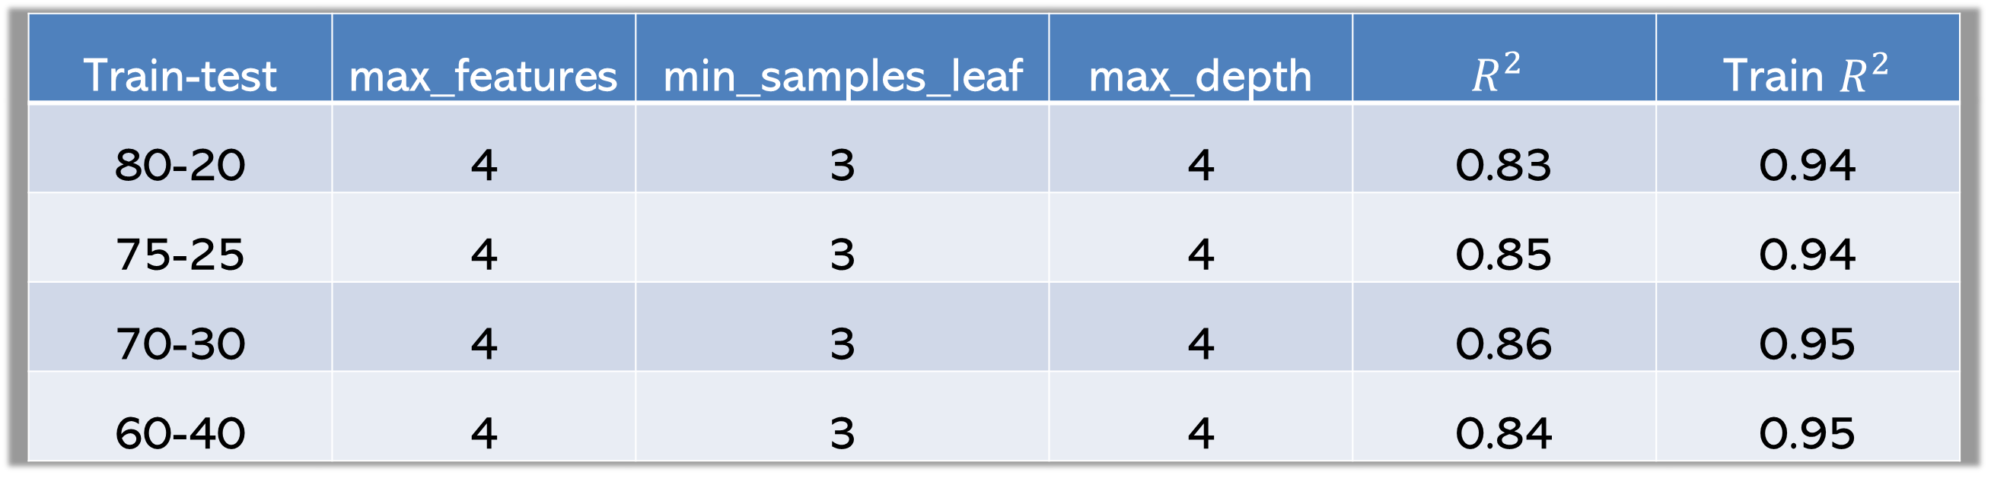
30
Random Forest
Train-test | max_features | min_samples_leaf | max_depth | $$R^{2}$$ | Train $R^{2}$
80-20 | 4 | 3 | 4 | 0.83 | 0.94
75-25 | 4 | 3 | 4 | 0.85 | 0.94
70-30 | 4 | 3 | 4 | 0.86 | 0.95
60-40 | 4 | 3 | 4 | 0.84 | 0.95
Here the Random Forest Tree is consistent for different train-test ratio’s as
$R^{2}$ is in around 83% to 86%.
* Please refer to Appendix page 44 for a details code

Slide 31
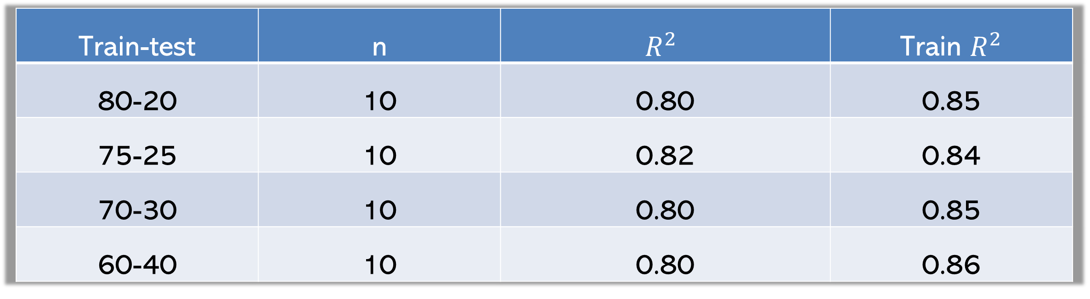

31
KNN
Train-test | n | $$R^{2}$$ | Train $R^{2}$
80-20 | 10 | 0.80 | 0.85
75-25 | 10 | 0.82 | 0.84
70-30 | 10 | 0.80 | 0.85
60-40 | 10 | 0.80 | 0.86
Here the KNN is consistent for different train-test ratio’s as $R^{2}$ is about 80%.

Slide 32

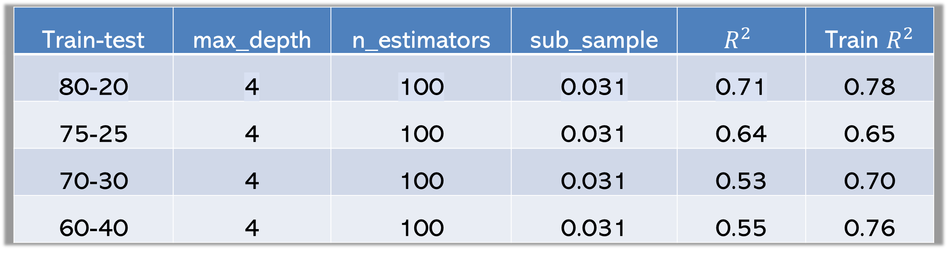

32
XGBoosting
Train-test | max_depth | n_estimators | sub_sample | $$R^{2}$$ | Train $R^{2}$
80-20 | 4 | 100 | 0.031 | 0.71 | 0.78
75-25 | 4 | 100 | 0.031 | 0.64 | 0.65
70-30 | 4 | 100 | 0.031 | 0.53 | 0.70
60-40 | 4 | 100 | 0.031 | 0.55 | 0.76
Here the XGBoosting is not consistent for different train-test ratio’s as
$R^{2}$ is ranging between 50% - 70%.
Notes:
Boosting algorithm combines multiple weak learners in a sequential method, which iteratively improves better predictability. on trying multiple parameters to overcome the overfitting issues at different train test splits., the best parameters are …………….., and
The best performance is observed with the 80-20 split, where the test R² is 0.71 and train R² is 0.78. This indicates a good balance between training and testing performance

Slide 33

33
Bagging
train-test | n_estimator | max_samples | max_features | R^2 | MSE
80-20 | 99 | 0.8 | 4 | 0.87 | 33.37
75-25 | 99 | 0.8 | 4 | 0.86 | 44.92
70-30 | 99 | 0.8 | 4 | 0.86 | 48.88
60-40 | 99 | 0.8 | 4 | 0.86 | 47.49
Here the Bagging is consistent for different train-test ratio’s as $R^{2}$ is ranging is around 86%.
Notes:
Bagging is an ensemble method that involves training multiple models independently on random subsets of the data, and aggregate their predictions.
With paramerters …………. Train R^2 are consistent around 86 %.

Slide 34

34
Results
Models/splits | 80-20 | 75-25 | 70-30 | 60-40
Multiple Linear Regression | 0.87 | 0.88 | 0.87 | 0.86
Random Forest | 0.85 | 0.87 | 0.86 | 0.87
Decision Tree | 0.73 | 0.74 | 0.69 | 0.72
KNN | 0.80 | 0.82 | 0.80 | 0.80
SVR | 0.73 | 0.74 | 0.75 | 0.73
Bagging | 0.87 | 0.86 | 0.86 | 0.86
XGBoosting | 0.71 | 0.64 | 0.53 | 0.55
Here the Multiple linear is consistent for different train-test ratio’s as $R^{2}$ is 88%.

Slide 35
35
Conclusion
On comparing different machine learning algorithms the Multiple Linear Regression is the best model with best fit of 88%.
From Multiple Linear Regression:
Having more doctors and longer life expectancy for countries helps reduce infant deaths,
while having more children per family and higher health costs tend to increase it.

Slide 36
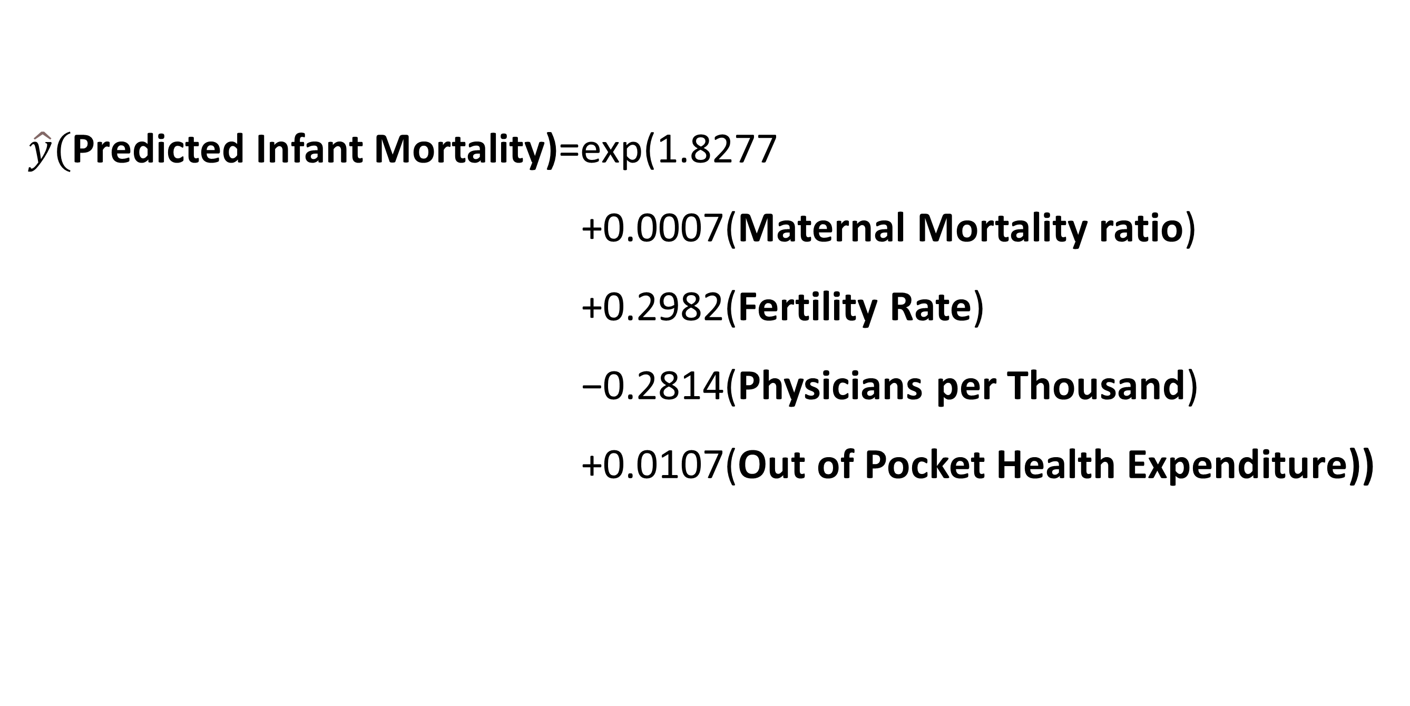
36
Linear model
$\hat{y}($Predicted Infant Mortality)=exp(1.8277
+0.0007(Maternal Mortality ratio)
+0.2982(Fertility Rate)
−0.2814(Physicians per Thousand)
+0.0107(Out of Pocket Health Expenditure))
Notes:
From this model we say that, infant mortality has positive coefficients with maternal mortality ratio, fertility rate, and out-of-pocket health expenditure
and a negative coefficient with physicians per thousand.
Which means that the infant mortality rate can be reduced by reducing the fertility rate and increasing the number of physicians per thousand, i.e., the number of doctors in the country.

Slide 37
37
Recommendation
The number of doctors(Physicians) in a country can reduce infant mortality.
In order to reduce infant mortality in the country, the government must focus on improving the number of doctors and the Healthcare infrastructure.
Promote Family Planning and Education, a need for policies that promote family planning, reproductive health education, and women’s empowerment, aiming to reduce high fertility rates

Slide 38
38
Thank you
Ruchitha | Shravanthika | Ramya | Madirai | Deepika

Slide 39
Contributions
39
Ruchitha
Worked on Exploratory Data Analysis
Shravanthika
Worked on Data Cleaning, and implementing methods
Ramya
Worked on Multicollinearity
Madirai
Worked on data modeling
Deepika
Worked on data modeling

Slide 40
40
Appendix

Slide 41
Variable Name | Description
Country | Name of the country.
Density (P/Km²) | Population density measured in persons per square kilometer.
Agricultural Land (%) | Percentage of total land area that is used for agriculture.
Land Area (Km²) | Total land area of the country in square kilometers.
Armed Forces Size | Number of personnel in the country's armed forces.
Birth Rate | Number of live births per 1,000 people in a year.
CO2 Emissions | Amount of carbon dioxide emissions in metric tons.
CPI | Consumer Price Index, a measure of the average change in prices over time.
CPI Change (%) | Percentage change in the Consumer Price Index over a specified period.
Fertility Rate | Average number of children born to a woman during her lifetime.
Forested Area (%) | Percentage of the total land area covered by forests.
Gasoline Price | Price of gasoline per liter.
GDP | Gross Domestic Product, total monetary value of all goods and services produced in a country.
Gross Primary Education Enrollment (%) | Percentage of children of official primary school age enrolled in primary school.
Gross Tertiary Education Enrollment (%) | Percentage of individuals of official tertiary education age enrolled in tertiary education.
Infant Mortality | Number of deaths of infants under one year old per 1,000 live births.
Life Expectancy | Average number of years a person is expected to live.
Maternal Mortality Ratio | Number of maternal deaths per 100,000 live births.
Minimum Wage | Lowest legal wage that can be paid to workers.
Out of Pocket Health Expenditure | Percentage of health expenses paid directly by individuals rather than covered by insurance.
Physicians per Thousand | Number of physicians per 1,000 people in the population.
Population | Total number of people living in the country.
Population: Labor Force Participation (%) | Percentage of the working-age population that is part of the labor force.
Tax Revenue (%) | Government tax revenue as a percentage of GDP.
Total Tax Rate | Total tax burden on businesses as a percentage of commercial profits.
Unemployment Rate | Percentage of the labor force that is unemployed and actively seeking employment.
Urban Population | Percentage of the total population living in urban areas.
GDP per Capita | GDP divided by the total population, representing average economic output per person.
41
Data Description:
Notes:
Variable Name : Description Country : Name of the country. Density (P/Km²) : Population density measured in persons per square kilometer. Agricultural Land (%) : Percentage of total land area that is used for agriculture. Land Area (Km²) : Total land area of the country in square kilometers. Armed Forces Size : Number of personnel in the country's armed forces. Birth Rate : Number of live births per 1,000 people in a year. CO2 Emissions : Amount of carbon dioxide emissions in metric tons. CPI : Consumer Price Index, a measure of the average change in prices over time. CPI Change (%) : Percentage change in the Consumer Price Index over a specified period. Fertility Rate : Average number of children born to a woman during her lifetime. Forested Area (%) : Percentage of the total land area covered by forests. Gasoline Price : Price of gasoline per liter. GDP : Gross Domestic Product, total monetary value of all goods and services produced in a country. Gross Primary Education Enrollment (%) : Percentage of children of official primary school age enrolled in primary school. Gross Tertiary Education Enrollment (%) : Percentage of individuals of official tertiary education age enrolled in tertiary education. Infant Mortality : Number of deaths of infants under one year old per 1,000 live births. Life Expectancy : Average number of years a person is expected to live. Maternal Mortality Ratio : Number of maternal deaths per 100,000 live births. Minimum Wage : Lowest legal wage that can be paid to workers. Out of Pocket Health Expenditure : Percentage of health expenses paid directly by individuals rather than covered by insurance. Physicians per Thousand : Number of physicians per 1,000 people in the population. Population : Total number of people living in the country. Population: Labor Force Participation (%) : Percentage of the working-age population that is part of the labor force. Tax Revenue (%) : Government tax revenue as a percentage of GDP. Total Tax Rate : Total tax burden on businesses as a percentage of commercial profits. Unemployment Rate : Percentage of the labor force that is unemployed and actively seeking employment. Urban Population : Percentage of the total population living in urban areas. GDP per Capita : GDP divided by the total population, representing average economic output per person.

Slide 42
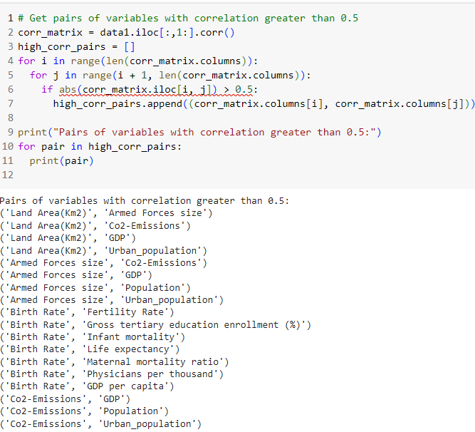
42
Pair of Features which are highly Correlated with each other

Slide 43
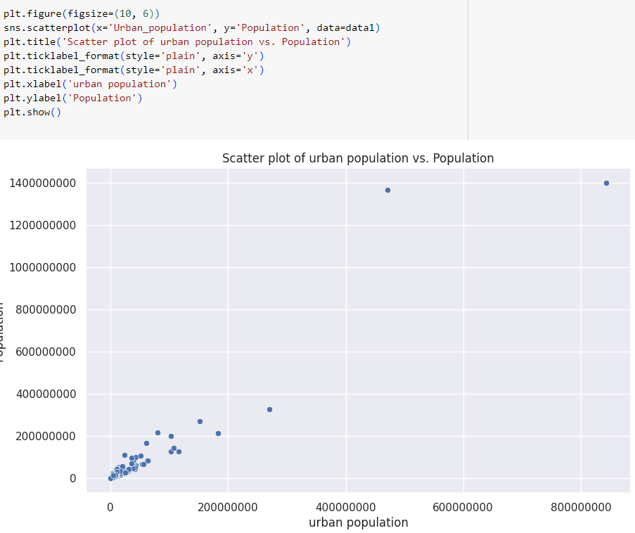
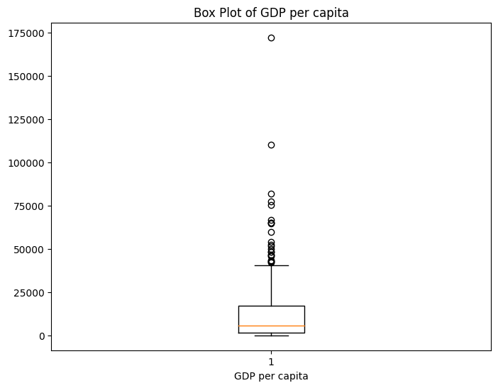
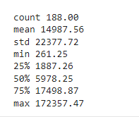
43
Scatter Plot between Urban Population and Population
Box Plot of GDP per Capita
Statistics of GDP per capita

Slide 44
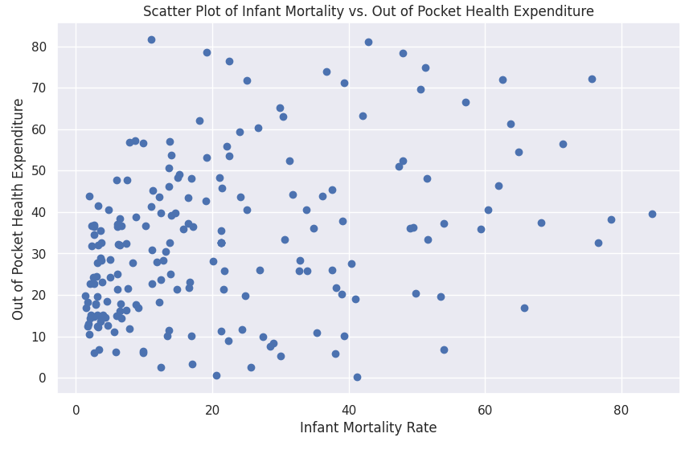
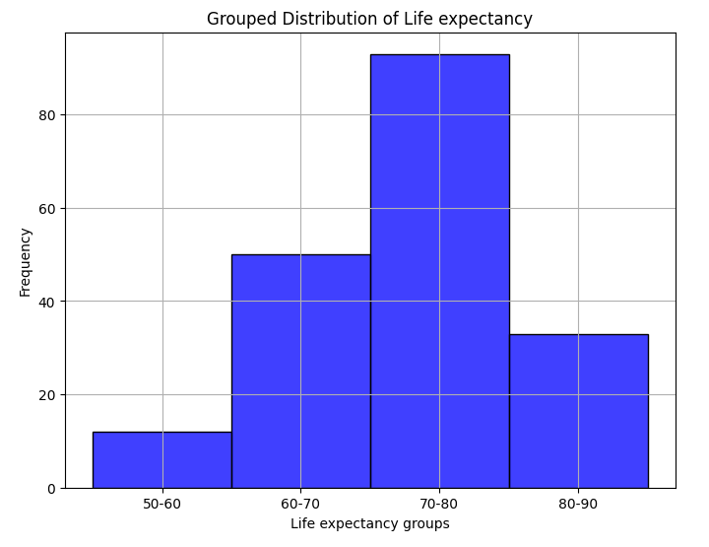
44
Scatter Plot of IMR and Pocket health Expenditure
Grouped Life Expectancy into Group

Slide 45
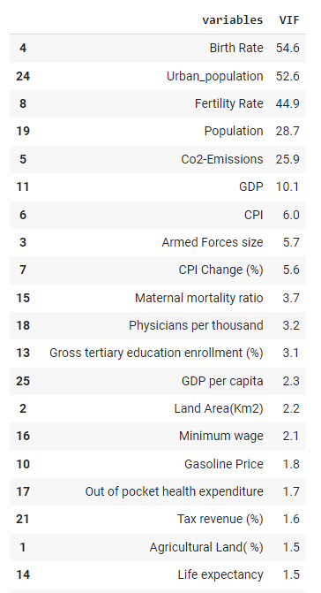
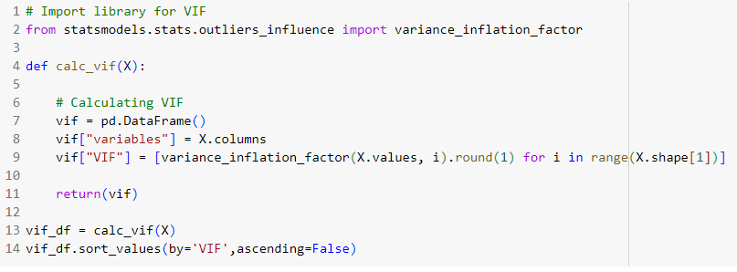
45
Code for Variance Inflation Factor (VIF)

Slide 46
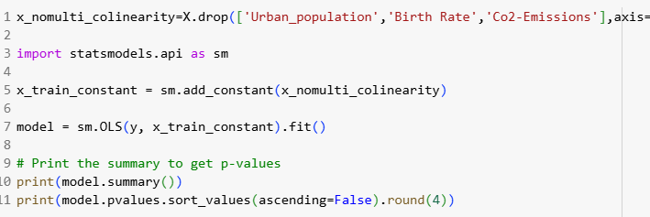
46
Code for Ordinary Least Square

Slide 47
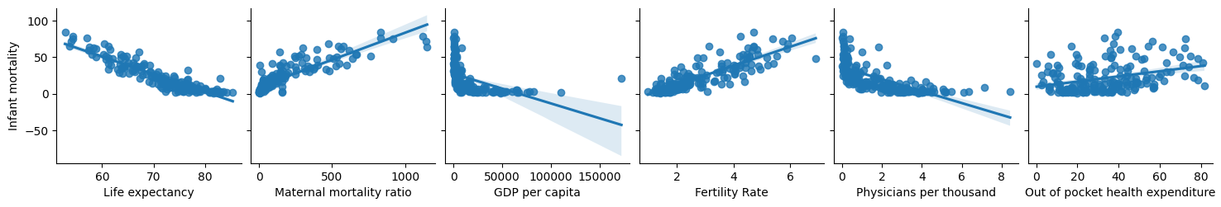
47
Pair plot for Significant Features

Slide 48
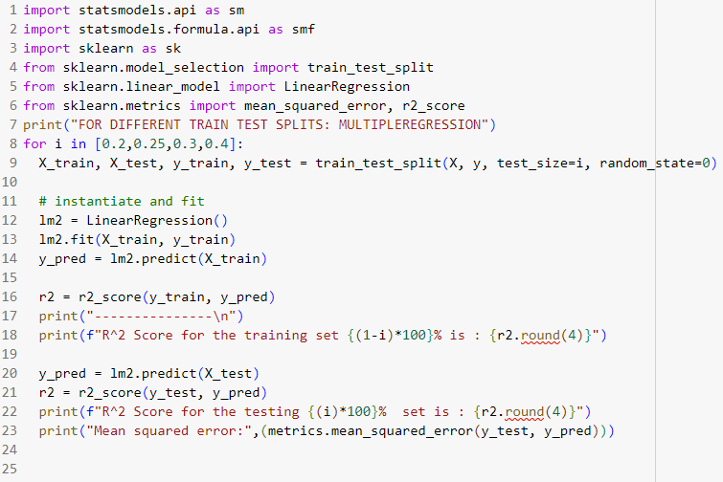
48
Multiple Linear Regression

Slide 49
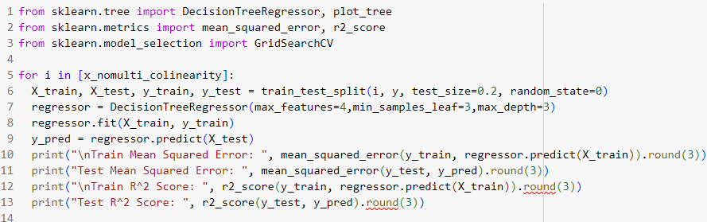
49
Decision Tree

Slide 50

50
Decision Tree Diagram

Slide 51

Random Forest
51

Slide 52

KNN
52

Slide 53

53
Support Vector Machine

Slide 54

54
XGBossting

Slide 55

55
Bagging

Slide 56

51
56
R² value is determined to find out how well an independent variable is described by the other independent variables. A high value of R² means that the variable is highly correlated with the other variables.

Slide 57
57
Thank you
Ruchitha | Shravanthika | Ramya | Madirai | Deepika

Slide 59
20
80-20 split
Models/splits | R^2
Multiple Regression | 0.927
Random Forest | 0.853
Dession Tree | 0.731
KNN | 0.803
SVR | 0.735
Bagging | 0.870
XGBoosting | 0.712
Here for 80-20 train-test split Multiple Regression is the best model as compared to the other models.

Slide 60
21
75-25 split
Models/splits | R^2
Multiple Regression | 0.933
Random Forest | 0.873
Dession Tree | 0.744
KNN | 0.820
SVR | 0.749
Bagging | 0.862
XGBoosting | 0.647
Here for 75-25 train-test split Multiple Regression is the best model as compared to the other models.

Slide 61
22
70-30 split
Models/splits | R^2
Multiple Regression | 0.926
Random Forest | 0.864
Dession Tree | 0.693
KNN | 0.807
SVR | 0.758
Bagging | 0.866
XGBoosting | 0.539
Here for 70-30 train-test split Multiple Regression is the best model as compared to the other models.

Slide 62
23
60-40 split
Models/splits | R^2
Multiple Regression | 0.913
Random Forest | 0.878
Dession Tree | 0.729
KNN | 0.802
SVR | 0.736
Bagging | 0.869
XGBoosting | 0.558
Here for 60-40 train-test split Multiple Regression is the best model as compared to the other models.

